Slide 1


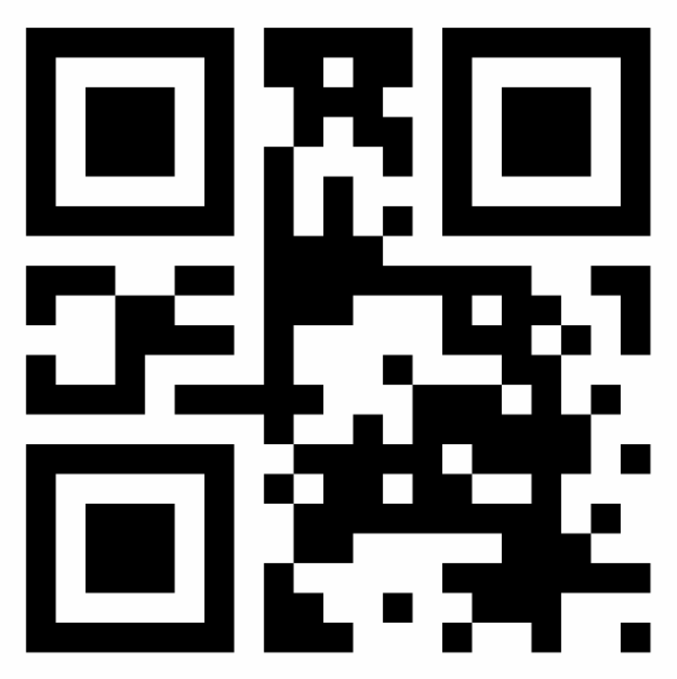

Wallet experience
If an airline user needs a wheelchair at the airport, they register in a wallet, bind to the vault that holds their verifiable credential attesting the wheelchair need, check-in with the airline, share the vault with the airline, and receive a sticker from the airline confirming that the credential was verified. At the airport, users just need to show the airline’s sticker.
1
To register with any wallet app... The app creates a wallet QR code that users can test with with a face scan.
To bind vaults, users login into their vault’s apps or websites, then click on the “bind with wallet” button. The wallet pops-up asking for confirmation. Once users agree, the handshake is done. The vault’s verifiable credentials are showed.
To check-in online, users click on the “open wallet” button on the 3P website or app. To check-in at a physical kiosk (e.g., airport), users scan their wallet’s QR.
When the 3P requests the user’s info codes, the wallet shows all bounded vaults that can attend the 3P’s requested codes, filtering only by the vaults that the 3P trusts, and asks the user to share them.
For info codes that the user doesn’t have bounded vaults that the 3P trusts, the wallet shows vaults suggested by the 3P.
The wallet shows the 3P sticker provided by the 3P, allowing for offline inspections. It allows for fraud check (with a signature) and ownership check (with a face hash). It also contains selected metadata that the 3P collected from the user’s vaults.
In closed circuits, like airports, users show the 3P stickers to staff with verifier apps.
2
1
Wallet registration
2
Vault binding
3
3P check-in – e.g. Japanese Airlines
7
3P closed circuit
e.g., London Heathrow Airport
Successfully registered
e.g., FR Mobility
3P online check-in 3P physical kiosk
Vault’s user interface
Open wallet
W
3
W
Scan QR or type {broker, locator}
Scan QR
User
4
Share vaults with [JP Airlines] 3P?
Passport
✓ IDnow
Vaccination status
✓ Very Fly
Special Service Requests
✓ French Mobility
Wallet’s user interface
S
4
Bind [FR Mobility] vault
to [ACME] wallet?
Wallet’s user interface
3P Sticker
e.g. JP Air.
OK
verify signature
Yes
No
Cancel
5
verify
face
hash
Success!
Vault suggestions
ESTA (USA)
Seat preferences
Booking contacts
Allergies
JP Air. [3P] Sticker
Download
Verified info:
Passport
3rd dose vaccine
Wheelchair
Metadata:
Flight: BA501
Date: 02/11/22
Motor wheelchair
Expires: 10/01/22
IDnow >>
S
⬇
6
IATA >>
6
3P QR Verifier App
7
5
Airport Staff
e.g. London Heathrow

